Slide 1
Craft Beers and Breweries
Nicole Norelli
Allen Miller
https://youtu.be/PHfFZCpFru4
Notes:
2410 craft beers
558 breweries
Focused primarily:
ABV, IBU, types (IPA & Ales), geographical dist.
Cover summaries of variables, how interact.
ML technique to classify beer types
Insights into craft beer trends

Slide 2
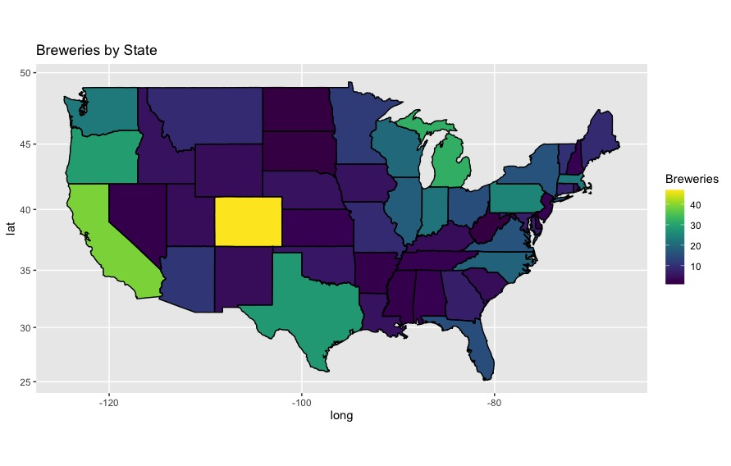
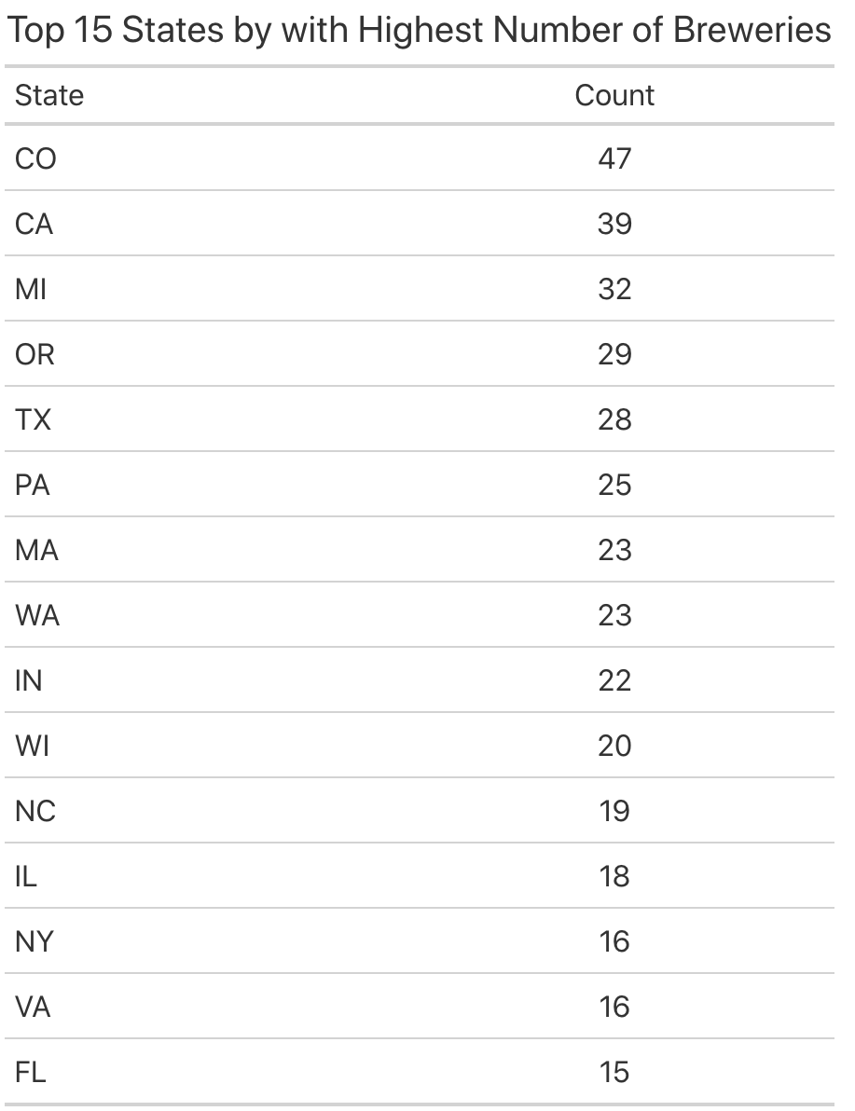
Number of Breweries per State
Notes:
All states + DC
CO: 47
Popular: CO, west coast, upper MW, TX

Slide 3
Missing Values
Problem:
ABV missing 62 values (2.6%)
IBU missing 1005 values (41.7%)
Resolution:
Omit for statistical analysis
Impute IBU values to improve machine learning classification
Notes:
To dive into the beer itself,
3% missing ABV data
40% missing IBU data
Not reported by the breweries, so the actual values are unavailable to us.
Remove beers w/ missing values from analysis re: ABV/IBU

Slide 4
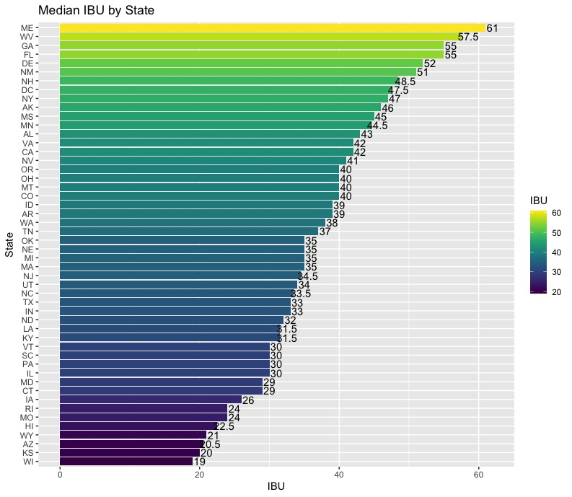
Median IBU by State
Range: 19-61
Note: SD removed (no IBU values)

Slide 5
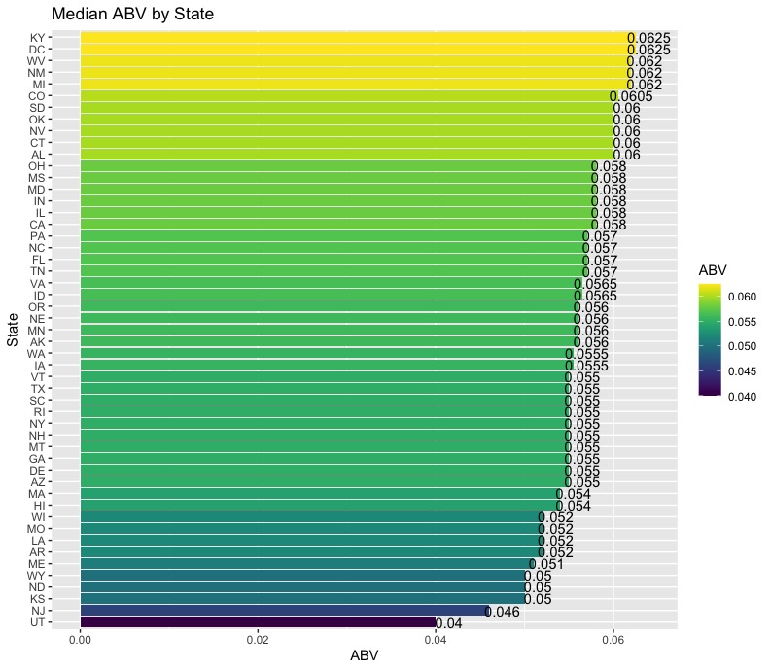
Median ABV by State
Range:
.04 (UT)
.0625 (KY)
Laws vary widely by state
Utah
4% ABV cap on grocery store sales
West Virginia
12% ABV cap on beer
Notes:
Range: .04 (UT) - .0625 (KY)
Laws pertaining to beer alcohol levels vary widely state by state.
Utah’s liquor laws are quite strict, so it’s not surprising they had the lowest median ABV. In Utah, beer purchased in grocery or convenience stores must be 4% or lower. Beer over 4% is considered liquor and must be purchased in liquor stores.
In contrast, West Virginia, which ranked 3rd on our chart, has a 12% ABV cap on beer.

Slide 6
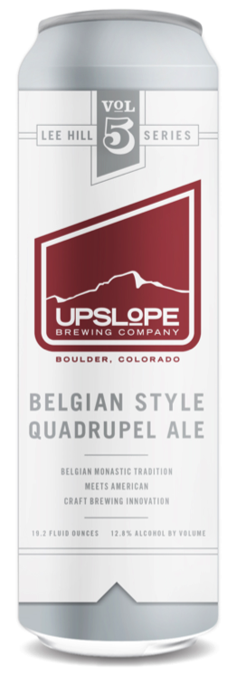
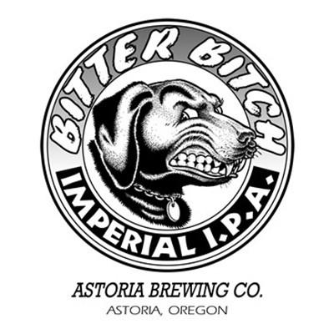
Highest ABV and IBU
Highest ABV: Colorado
Lee Hill Series Vol. 5 - Belgian Style Quadrupel Ale
Brewed By: Upslope Brewing Company
ABV: 0.128
Highest IBU: Oregon
Bitter Bitch Imperial IPA
Brewed By: Astoria Brewing Company
IBU: 138

Slide 7
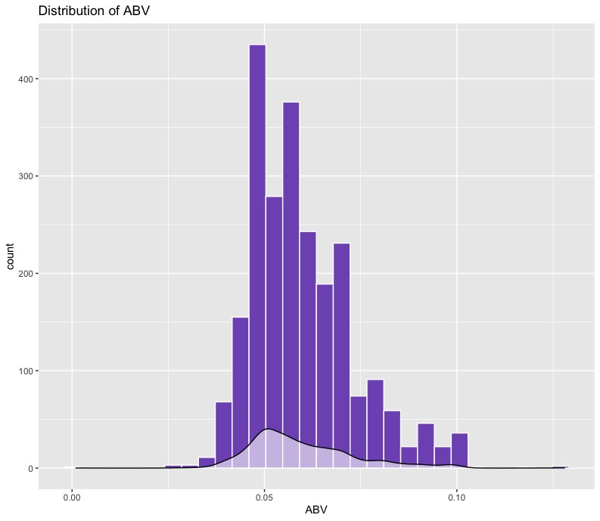
Alcohol Content
Summary Statistics:
Median: 0.056
Min: 0.001
Low Alcohol Beer
Max: 0.128
Standard Deviation: 0.0135
Right-skewed distribution
High ABV (imperial & quadrupel styles)
Notes:
A look at the distribution of alcohol by volume shows that the median is right around .05, although it ranges from .001 to .128. Beer typically contains between 4 and 7% ABV, as you can see.
At the low end of the range is obviously low alcohol beer.
There is a right skew, - high alc beer more spread in dist
Some of the imperial and quadrupel styles have relatively high ABV and contribute to this.

Slide 8
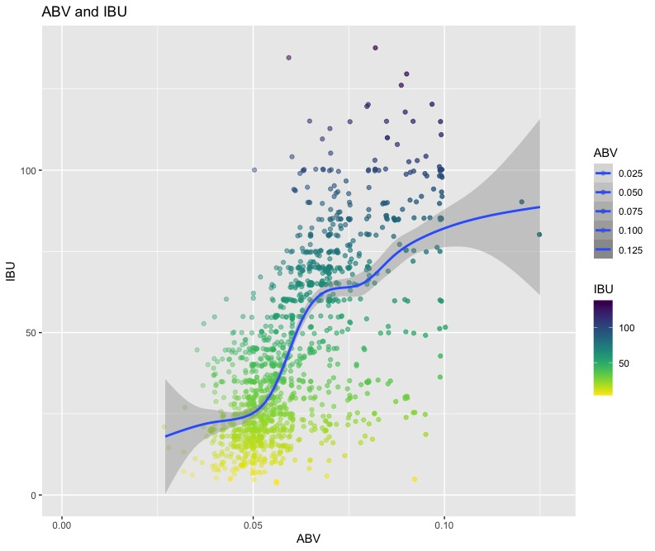
Relationship between ABV and IBU
Possible explanation: Brewing 101
Higher IBU = more hops
More hops = more bitter
To balance bitter = more malt (sugar)
More sugar + yeast = higher ABV

Slide 9
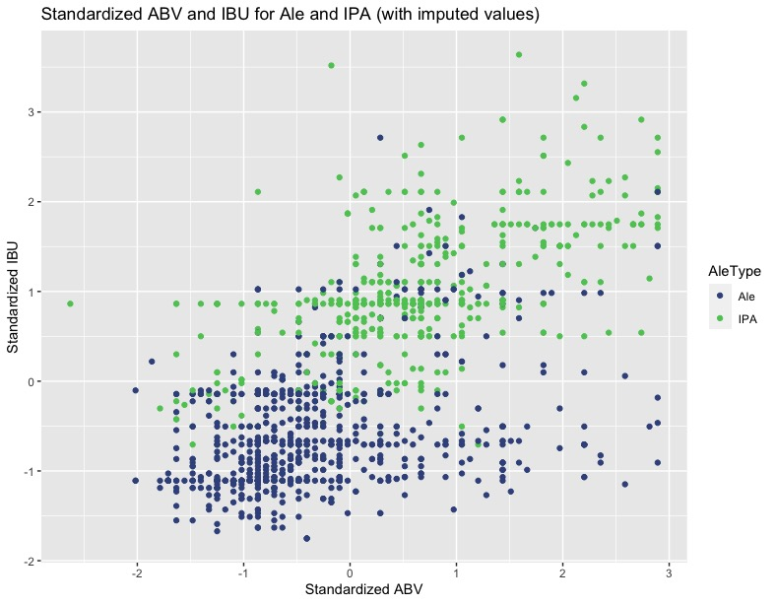
Classification of IPA and Ale
Predicts Ale or IPA using IBU and ABV
Best model: 29 nearest data points
Accuracy: 89.74%
Sensitivity: 91.62% (Correct ID of Ale)
Specificity: 86.61% (Correct ID of IPA)
Missing IBU values imputed with median IBU by style
Nearly 3% increase in accuracy

Slide 10
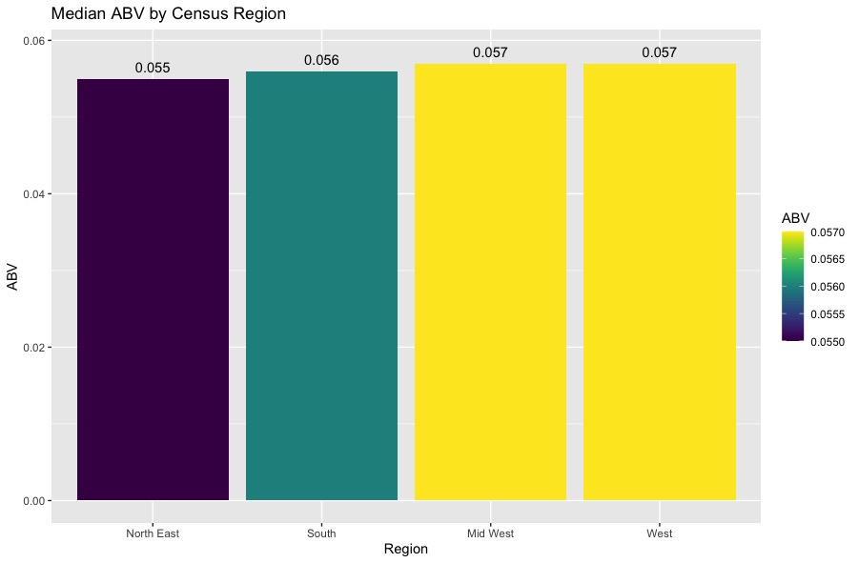
Median ABV by Census Region
4 U.S. Census Regions
Minimal ABV differences

Slide 11
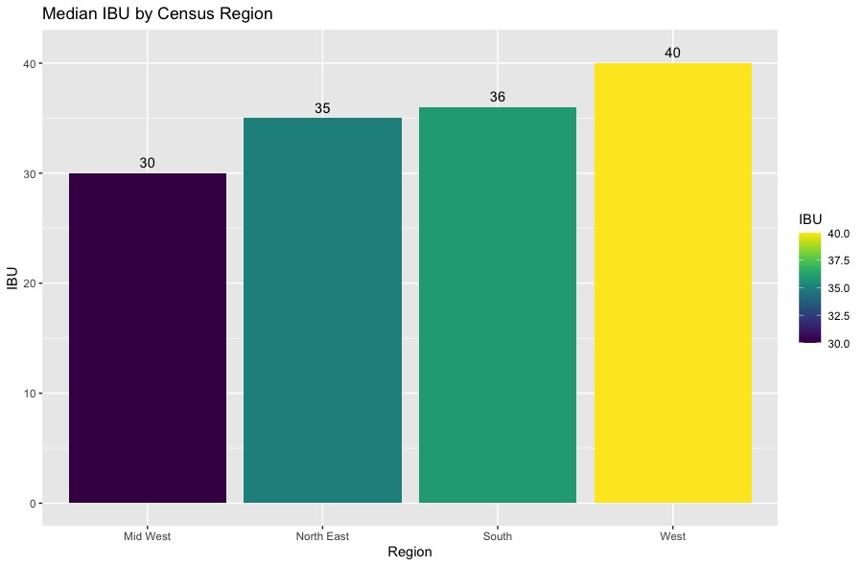
Median IBU Level By Census Region
West
Higher median IBU
Oregon had beer with highest IBU
Mid West
Lower median IBU

Slide 12
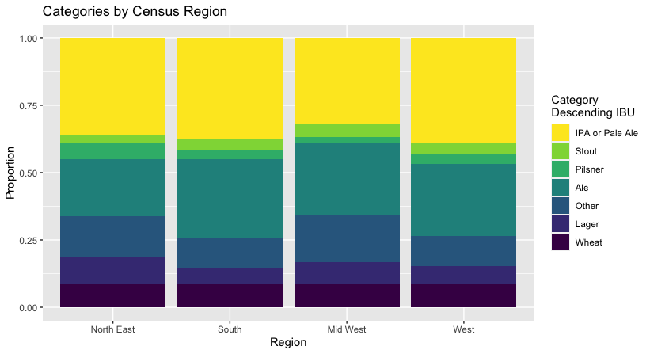
Category by Census Region
7 main beer types:
IPA/Pale Ale, Stout, Pilsner, Ale, Lager, Wheat, Other
Similar proportions
Mid West less IPA/Pale Ale
IPA & Ale most common in all regions

Slide 13
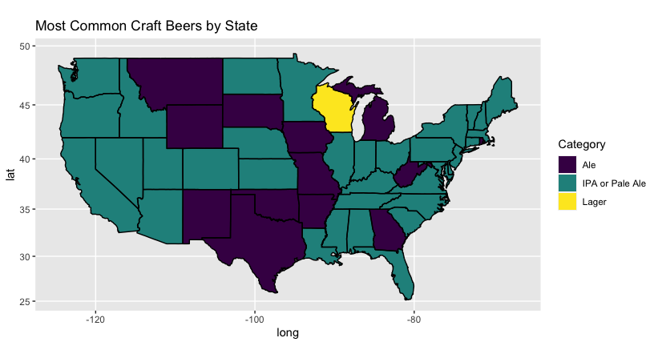
Most Common Beer Style by State
Most common: IPA
37 states and District of Columbia
Ale:
13 states
WI (Lager)
Market for IPA/Pale Ale throughout U.S.
Notes:
There seems to be a clear market for IPA/Pale Ale throughout the US, especially on the W coast. None of the major domestic beer producers are providing IPA. Could be an opportunity for Budweiser to fill an unmet need.

Slide 14

Questions or Comments?
Notes:
That concludes my presentation. Thank you!

